Slide 1


Bank Loan Analysis
Presented by Group 3

Slide 2





Arti
Adnan
Group Members
Jaideep
Karthik
Vaishnavi
Ratna

Slide 3

Bank Loan Analysis presentation
Index
1
Modules
6
Grade & subgrade wise Revolve balance
11
SQL queries
2
Datasets
7
Total payment for Verified vs non verified status
12
Power Bi dashboard
3
Data cleaning
8
State wise loan status
13
Tableau dashboard
4
KPI’s
9
Home Ownership vs last payment date status
14
Challenges
5
Year wise Loan amount status
10
Excel dashboard
15
Conclusion

Slide 4




MODULES
EXCEL
MY SQL
POWER BI
TABLEAU

Slide 5

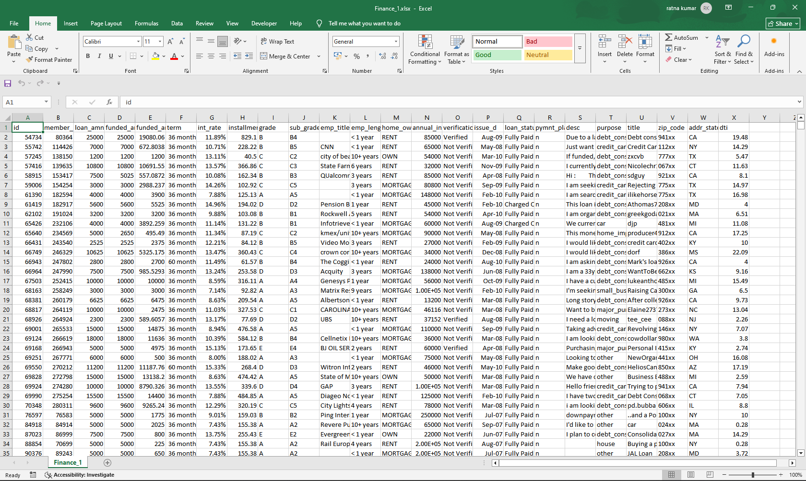

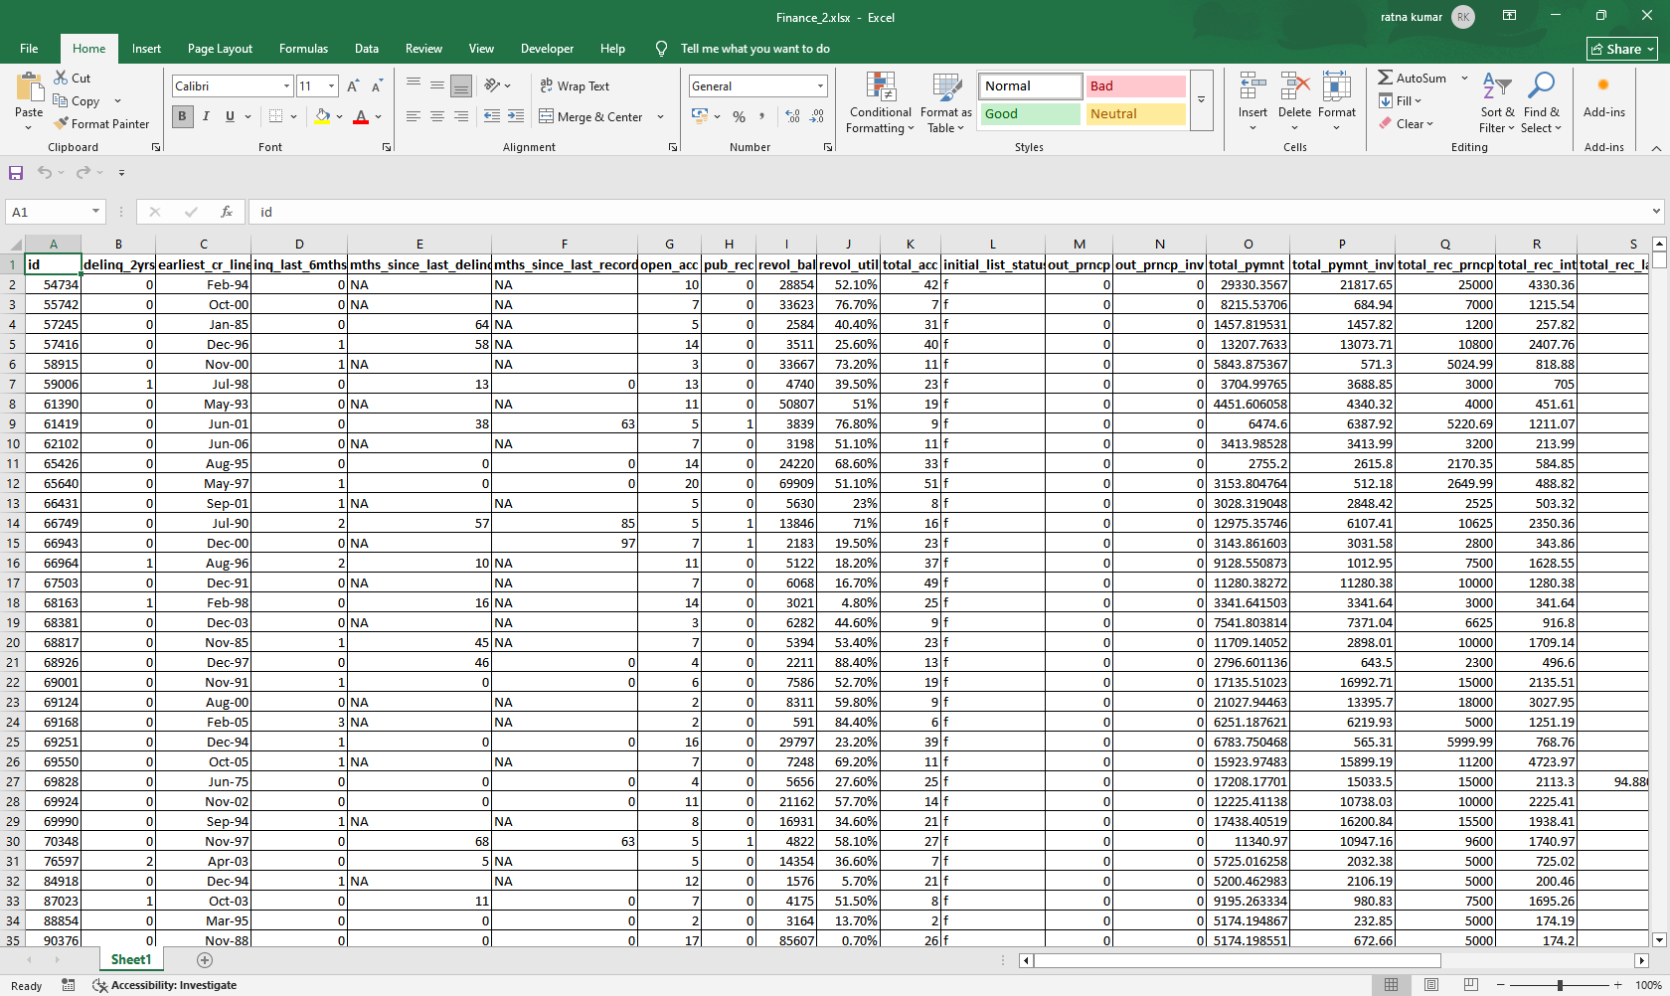
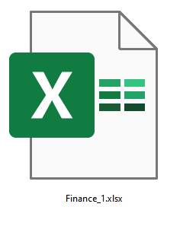
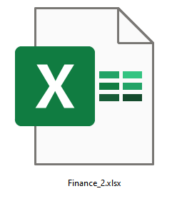
Datasets
Finance_1 and Finance_2 are the two datasets
used for analysis.

Slide 6







Data Cleaning
1. Removing columns: desc, payment_plan, title, emp_title these unnecessary columns are deleted.
2. Data types: “issue_date” column in finance_1 sheet was changed to “dd-mm-yyyy” format.
3. Null values: “emp_title” column had many null values, so this column was completely deleted from the database.

Slide 7

01
Year wise Loan amount status
02
Grade & subgrade wise Revolve bal
03
Total payment for Verified vs non verified status
04
State wise loan status
05
Home Ownership vs last payment date status

Slide 8
01
Year wise Loan amount status
The chart indicates significant increase in the total sum of loan amounts issued from 2007 to 2011.
The most dramatic growth occurs between 2010 and 2011 where the total loan amount doubles itself.

Slide 9
02
Grade & subgrade wise Revolve balance
The chart indicates that Grade A and Grade B have the highest total revolving balances, with subgrades A4, A5 being the highest in grade A. similarly, B3, B4, B5 in Grade B.
Grade F and G are having the lowest revolving balances with F5 and G5 being the lowest in their respective grades.

Slide 10
03
Total payment for Verified vs non verified status
More than half of the total population or dataset is verified, indication a higher rate of verification overall.
While majority of the percentage is verified still a little more than 41% is unverified indicating that there’s a room for improvement in the verification process.

Slide 11
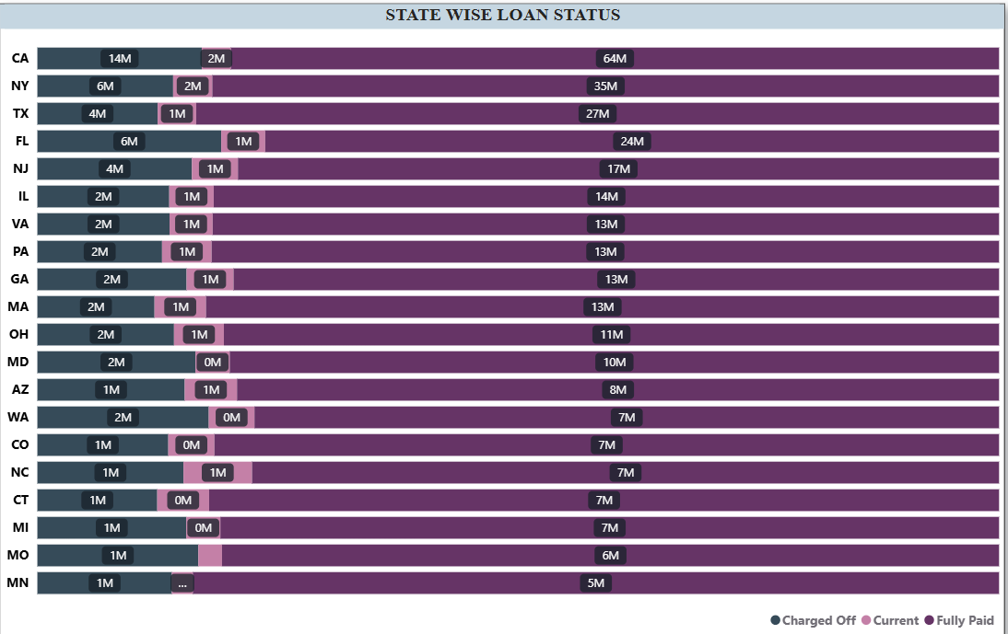
04
State wise loan status
We can observe that California has the highest count followed by new-york and Texas.
Most of the loans in almost every state are fully paid , which shows good repayment behavior overall.
A few states like Texas and New jersey have higher counts of current and charged-off-loans , which means repayments are still pending or at risk.

Slide 12
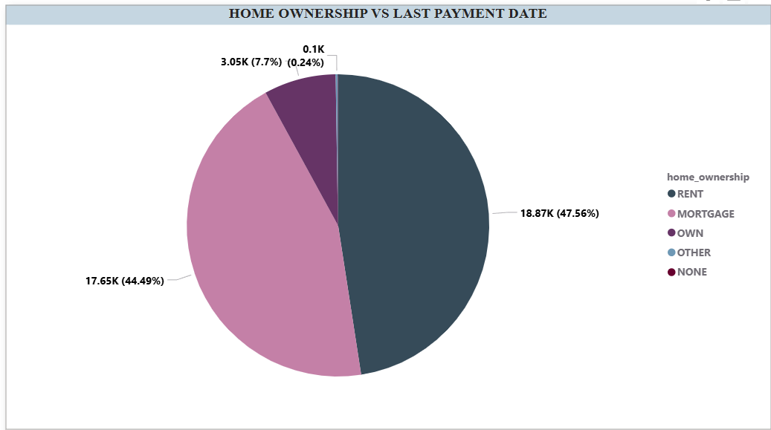
05
Home Ownership vs last payment date status
Renting is the most common category among individuals having count of 18.87k with 47.56%.
Mortgage holders are second largest group having 17.65k with 44.49%.
Combining mortgage 17.65k and own 3.05k categories shows that of 20.70k individuals have some form of homeownership.
These high number of mortgage indicates that a substantial portion of population has long term financial commitments related to housing.

Slide 13
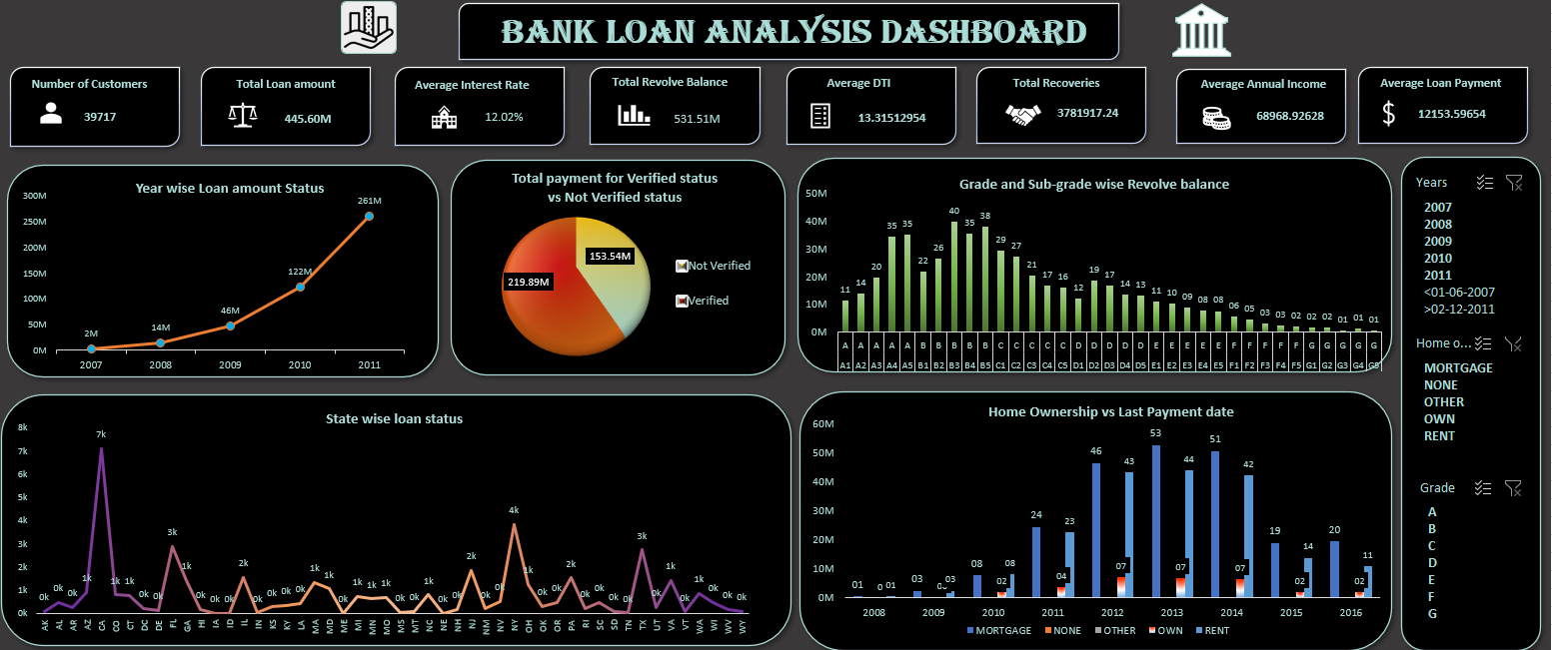
EXCEL DASHBOARD

Slide 14
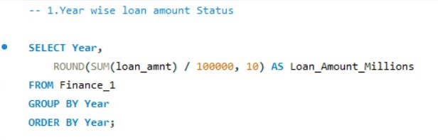
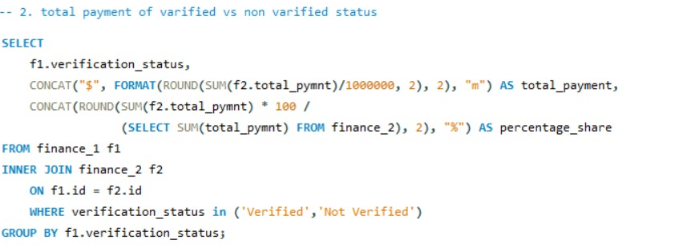
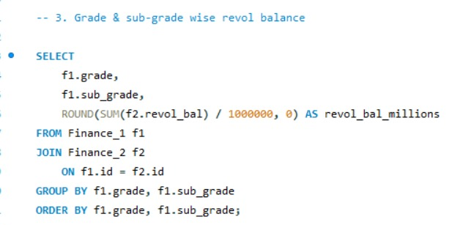
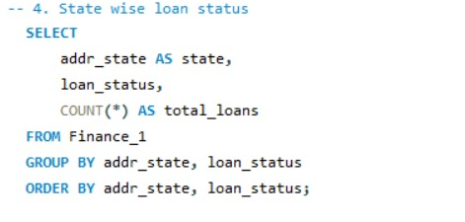
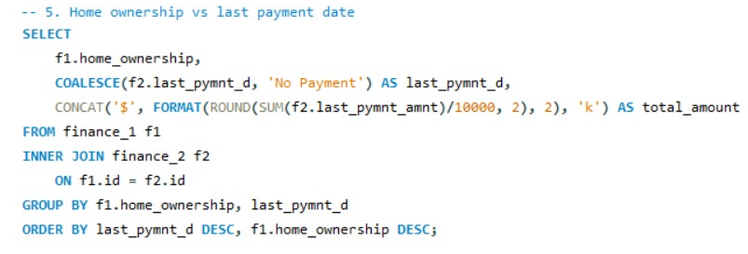
My SQL QUERIES
1
2
3
4
5

Slide 15
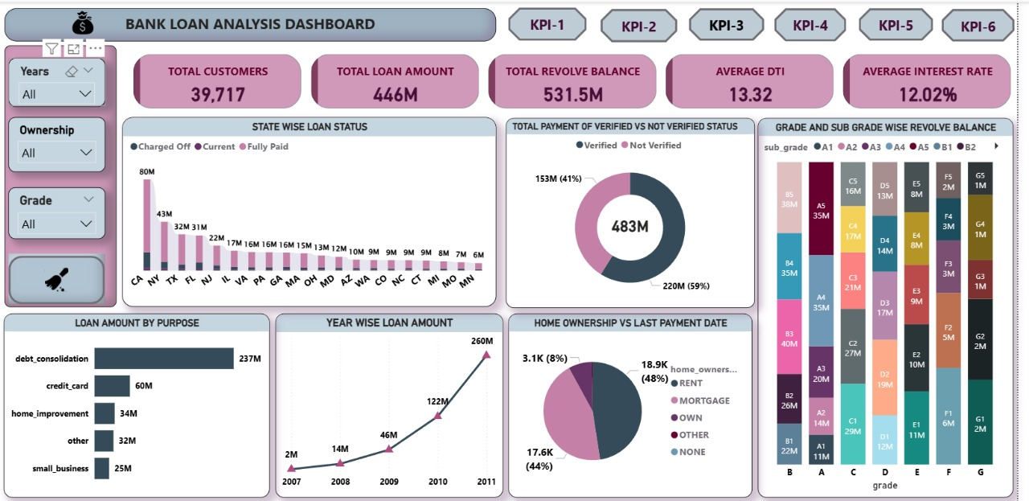
POWER BI DASHBOARD

Slide 16
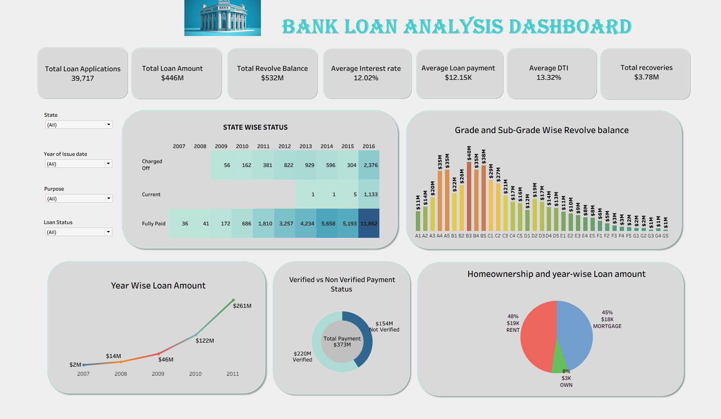
TABLEAU DASHBOARD

Slide 17
Challenges
As beginners, one big challenge was creating dashboards where values are shown clearly. Sometimes numbers or KPIs didn’t appear properly, so we had to adjust formatting.
Another challenge was choosing the right type of chart for each KPI. We experimented with different visuals to make sure the information was easy to understand.
Also, arranging the KPIs and charts in a way that looked professional and matched the assignment example was not easy at first.
Since this was our first project combining Excel, SQL, Power BI, and Tableau, learning and setting up dashboards across tools itself was challenging.

Slide 18
Conclusion
The analysis of Finance_1 and Finance_2 datasets through Excel, SQL, Power BI, and Tableau provided a complete view of loan performance and customer patterns.
Loan amounts showed steady growth from 2007–2009, with a sharp rise between 2010–2011, highlighting rapid expansion.
Grade & Subgrade analysis revealed Grade A and B borrowers hold the highest revolving balances, while Grades F and G remain low.
Verification trends indicate that a majority of loans are verified, though ~40% remain unverified, signaling scope for stronger validation processes.
State-wise analysis showed California, New York, and Texas as leading contributors in loan issuance.
Home ownership vs last payment trends gave insights into repayment behavior based on borrower profiles.
The Tableau dashboard offered interactive, user-friendly insights, complementing Excel, SQL, and Power BI results.

Slide 19


THANK YOU

